Slide 1
INFORMATION HIDING
Generated by DALL-E
DFT and DCT
Adib Nikjou, Shiraz University of Technology, Spring 2025

Slide 2
Lecture Overview Fundamentals of dft and dct
1. Fourier Analysis Fundamentals
Basic principles of Fourier theorem
Discrete Fourier Transform (DFT) definition and properties
Mathematical foundation and complex number representation
Parseval's theorem and Euclidean distance preservation
2. DFT Properties and Applications
Time-domain shift properties
Amplitude and energy spectrum
Fast Fourier Transform (FFT) efficiency
Multi-dimensional DFT applications

Slide 3
Lecture Overview Fundamentals of dft and dct
3. Discrete Cosine Transform (DCT)
DCT principles and energy concentration
Comparison with DFT for correlated signals
1D and 2D DCT formulations
Fast DCT algorithms and complexity
4. DCT in Image Processing
2D DCT implementation
Zig-zag coefficient ordering
DCT coefficient distributions
Block-based DCT coding

Slide 4
Lecture Overview Fundamentals of dft and dct
5. Compression Using DCT
Data decorrelation and energy compaction
Quantization process
Statistical encoding
Practical examples and visual results

Slide 5
FOURIER SERIES (FS)

Slide 6
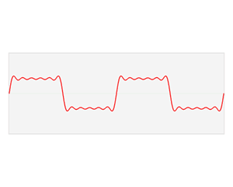
Fourier Analysis Fundamentals The Core Principle
Fourier's Theorem: Any periodic and continuous function can be represented as a sum of sinusoidal functions.
Transforms signals from time/spatial domain to frequency domain
Reveals hidden frequency components in seemingly complex signals

Slide 7
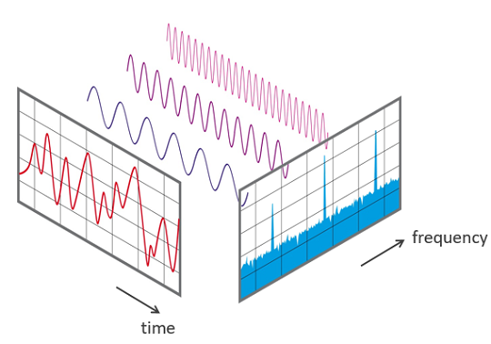
Fourier Analysis Fundamentals fourier series
Even though the original signal is continuous in time, because it's periodic, its frequency components are discrete.
The Fourier Series gives us a set of discrete frequency components (harmonics of the fundamental frequency).

Slide 8
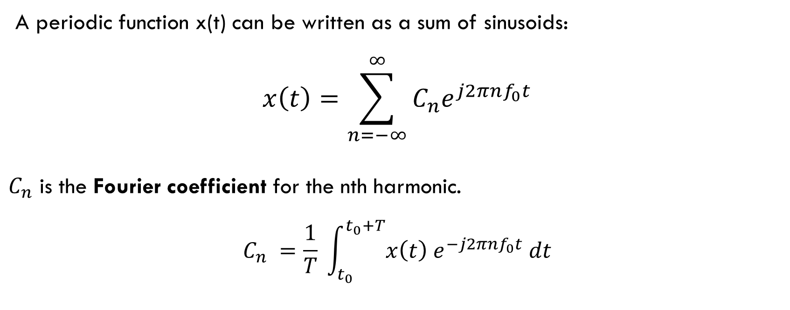
Fourier Analysis Fundamentals fourier series
A periodic function x(t) can be written as a sum of sinusoids:
$$x\left(t\right)=\sum_{n=−∞}^{∞}{C_{n}e^{j2πnf_{0}t}}$$
$C_{n}$​ is the Fourier coefficient for the nth harmonic.
$$C_{n} =\frac{1}{T} \int_{t_{0}}^{t_{0}+T}{x\left(t\right) e^{−j2πnf_{0}t} dt}$$

Slide 9
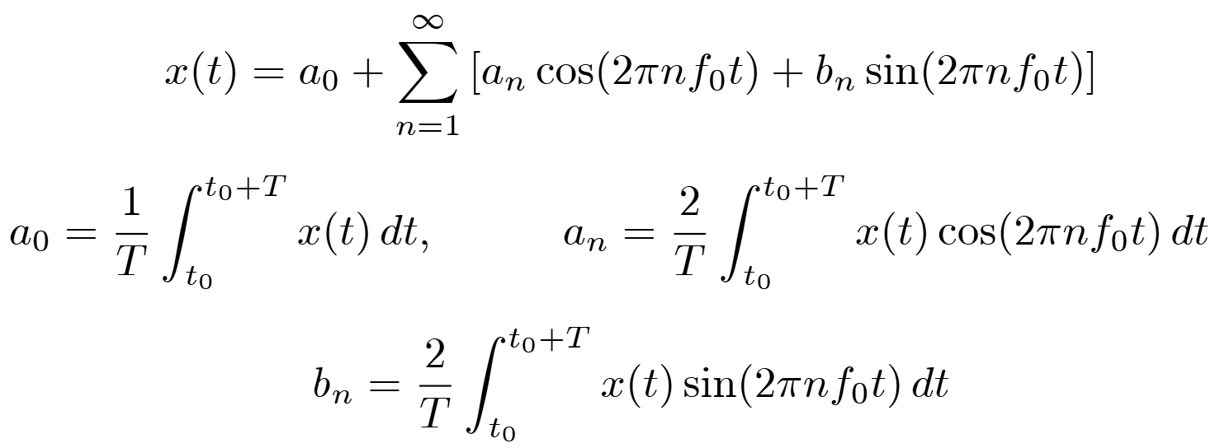
Fourier Analysis Fundamentals fourier series – real sinusoids
Or using real sinusoids:
DC Term

Slide 10
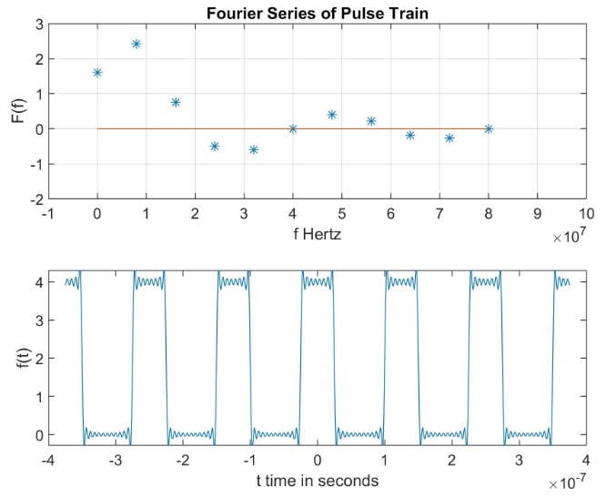
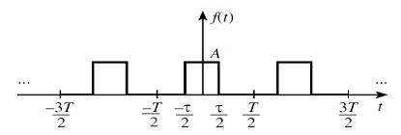
Fourier Analysis Fundamentals fourier series example

Slide 11
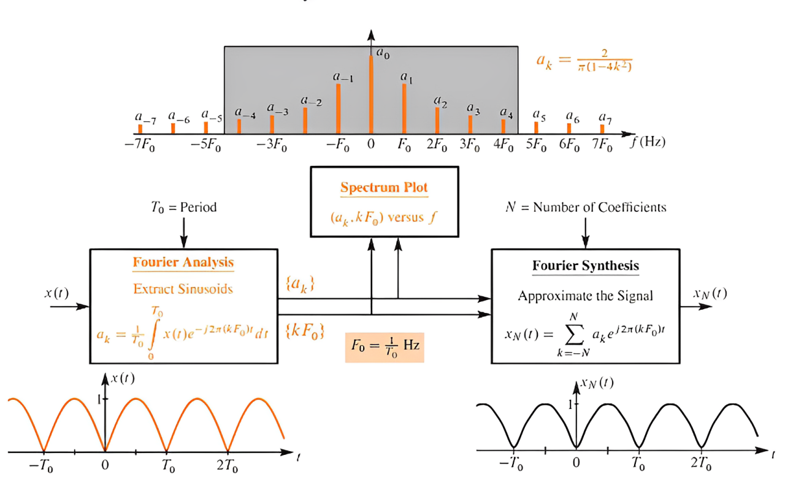
Fourier Analysis Fundamentals Fourier series synthesis

Slide 12
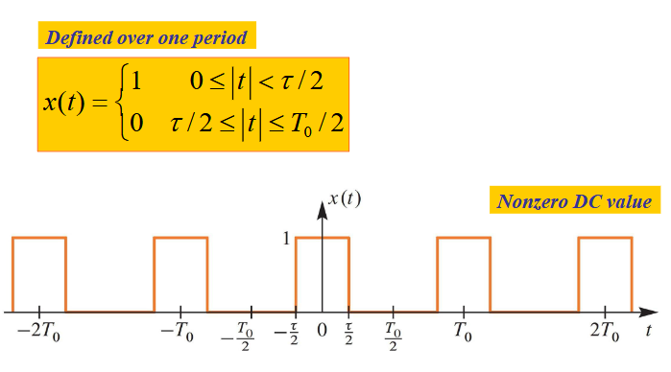
Fourier Analysis Fundamentals Fourier series - Pulse wave signal (general form)

Slide 13
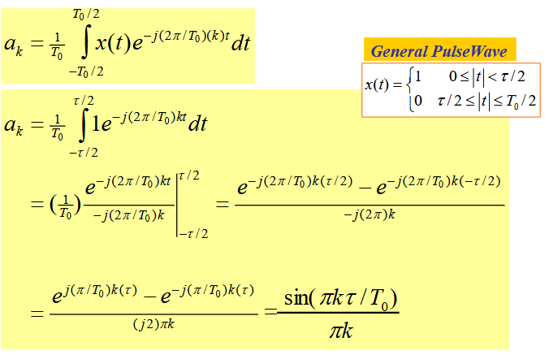
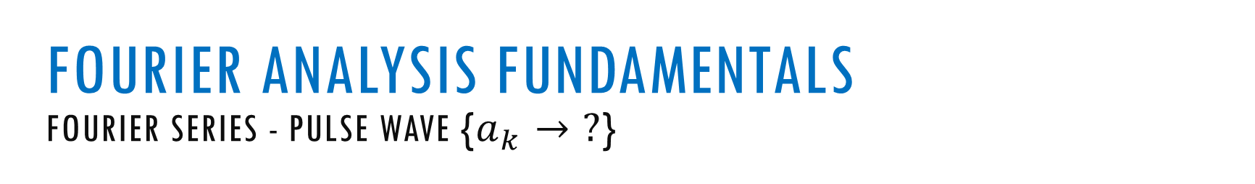
Fourier Analysis Fundamentals Fourier series - Pulse wave {$a_{k}→ ?$}

Slide 14
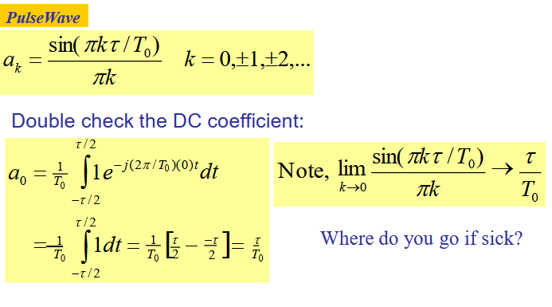

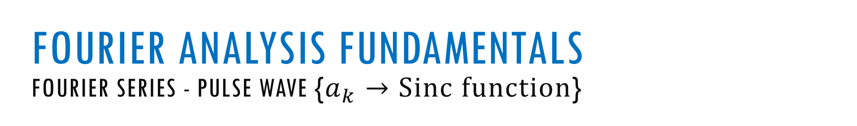

Fourier Analysis Fundamentals Fourier series - Pulse wave {$a_{k}→Sinc function$}

Slide 15
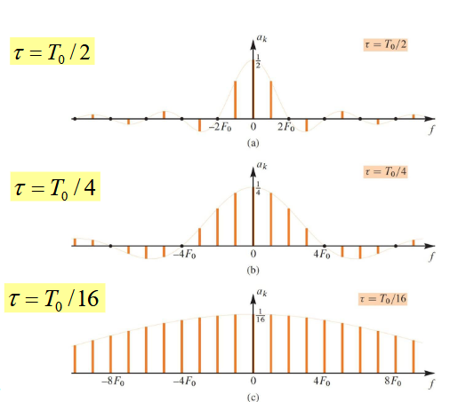
Fourier Analysis Fundamentals Fourier series - Pulse wave Spectra

Slide 16
FOURIER TRANSFORM (FT)

Slide 17
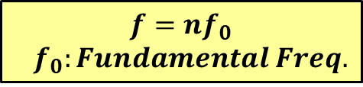
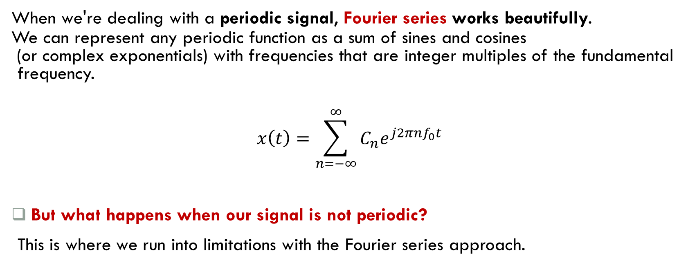
Fourier Analysis Fundamentals Fourier Series vs. Fourier Transform
When we're dealing with a periodic signal, Fourier series works beautifully.
We can represent any periodic function as a sum of sines and cosines
(or complex exponentials) with frequencies that are integer multiples of the fundamental frequency.
$$x\left(t\right)=\sum_{n=−∞}^{∞}{C_{n}e^{j2πnf_{0}t}}$$
But what happens when our signal is not periodic?
This is where we run into limitations with the Fourier series approach.
$$f=nf_{0}$$
$$f_{0}:Fundamental Freq.$$

Slide 18
Fourier Analysis Fundamentals Fourier Series vs. Fourier Transform
For non-periodic signals, we can think of them as having an "infinite period" - they never repeat.
If we try to apply it to Fourier series directly, we have:
The fundamental frequency would approach zero (since T → ∞)
The discrete frequency components would become infinitely close together

Slide 19
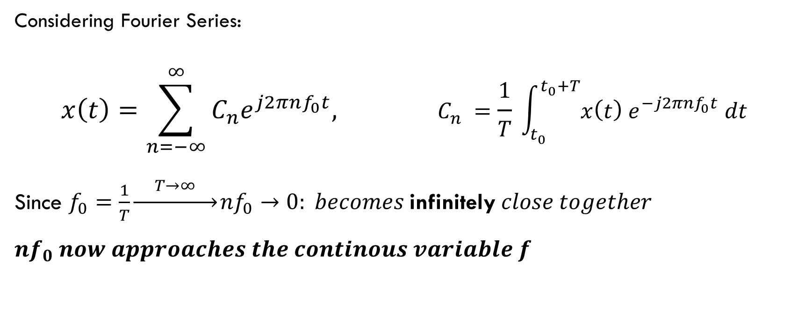
Fourier Analysis Fundamentals Fourier Series vs. Fourier Transform
Considering Fourier Series:
$$x\left(t\right)=\sum_{n=−∞}^{∞}{C_{n}e^{j2πnf_{0}t}, }C_{n} =\frac{1}{T} \int_{t_{0}}^{t_{0}+T}{x\left(t\right) e^{−j2πnf_{0}t} dt}$$
Since $f_{0}=\frac{1}{T}\underset{→}{ T→∞ }{nf}_{0}→0: becomes \text{infinitely} close together$
$$nf_{0} now approaches the continous variable f$$

Slide 20
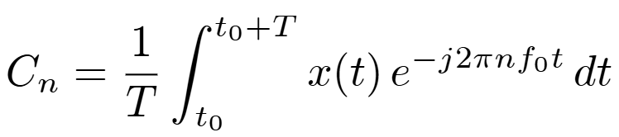
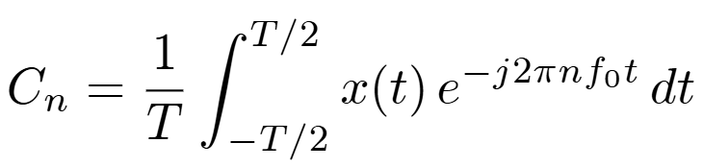
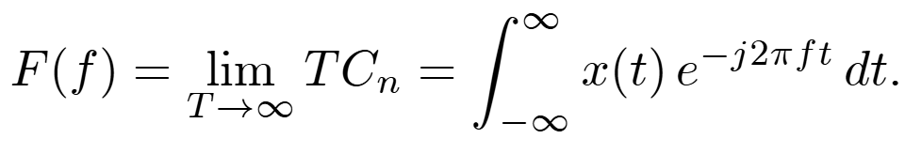
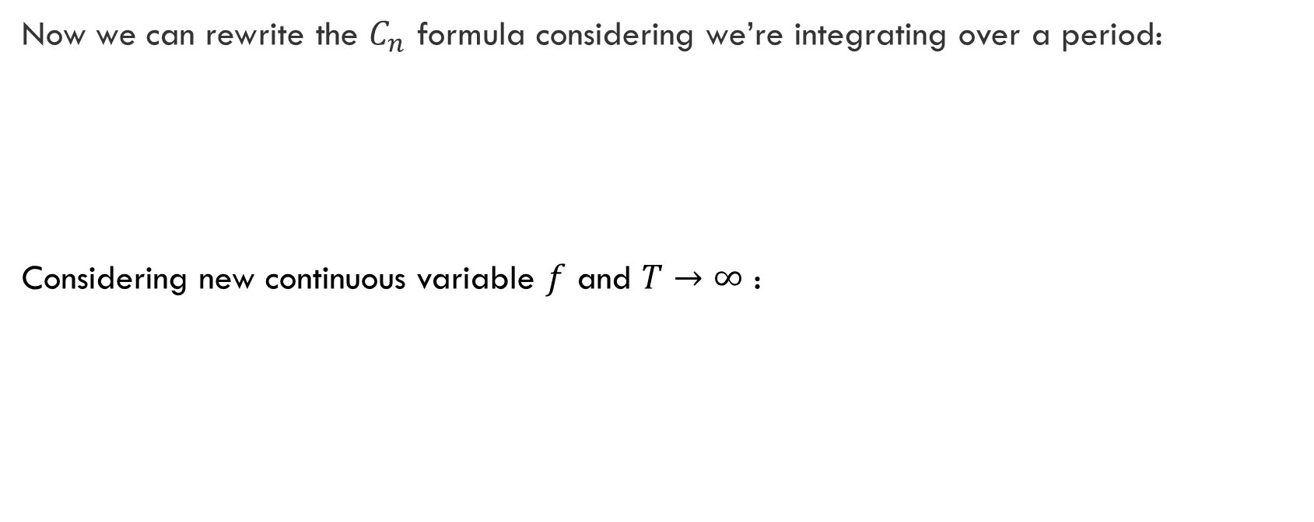
Fourier Analysis Fundamentals Fourier Series vs. Fourier Transform
Now we can rewrite the $C_{n}$ formula considering we’re integrating over a period:
Considering new continuous variable $f$ and $T→∞$ :

Slide 21
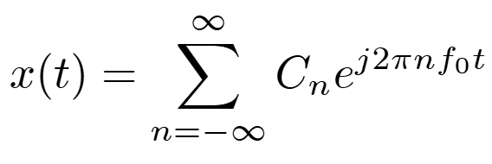
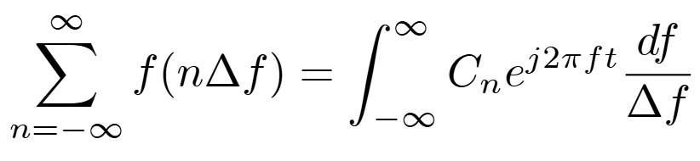
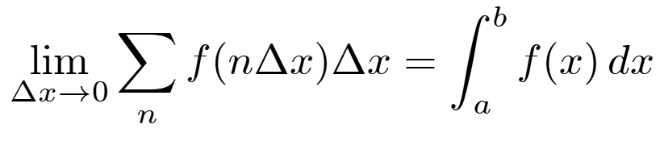
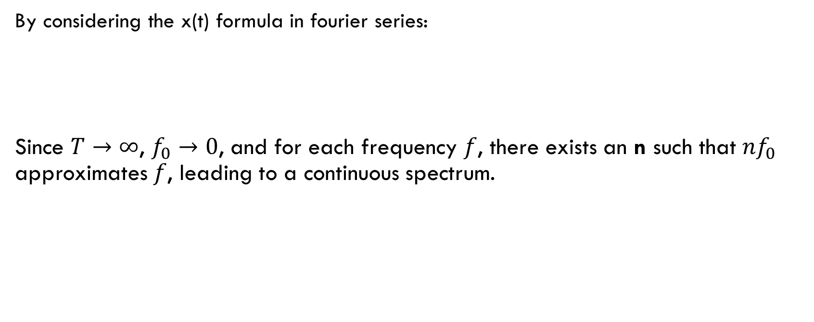
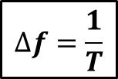

Fourier Analysis Fundamentals Fourier Series vs. Fourier Transform
By considering the x(t) formula in fourier series:
Since $T→∞$, $f_{0}→0$, and for each frequency $f$, there exists an n such that $nf_{0}$ approximates $f$, leading to a continuous spectrum.
$$∆f=\frac{1}{T}$$
Riemann sum to integral conversion
Scaling

Slide 22
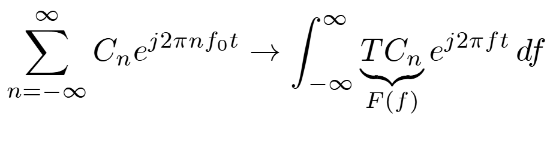
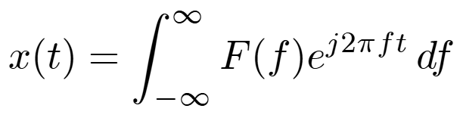
Fourier Analysis Fundamentals Fourier Series vs. Fourier Transform
So that x(t) becomes:

Slide 23
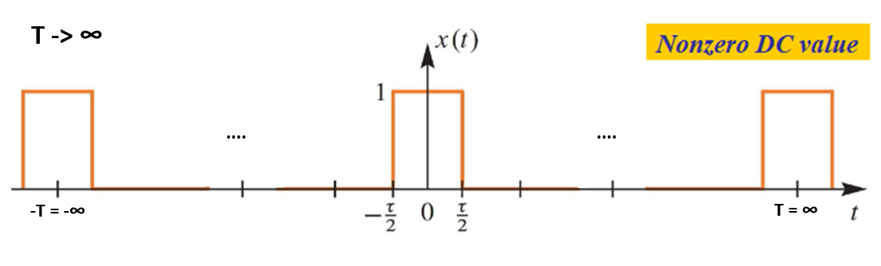
Fourier Analysis Fundamentals Fourier Transform

Slide 24
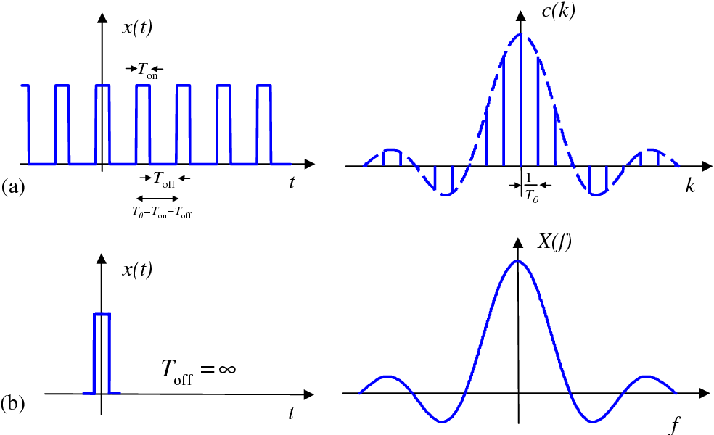
Fourier Analysis Fundamentals Fourier Transform

Slide 25
Discrete-Time Fourier Transform (DTFT)

Slide 26
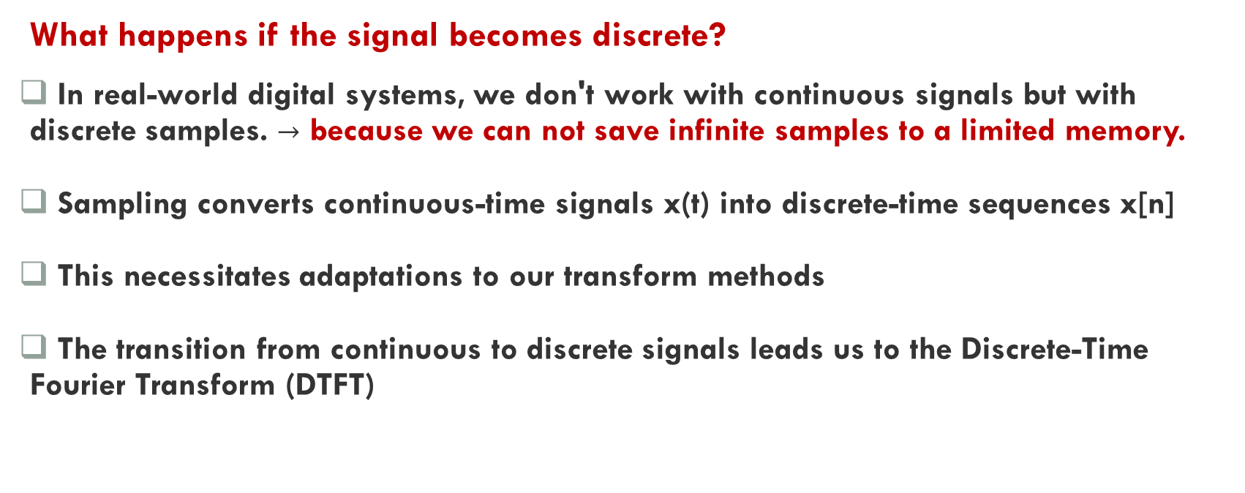
Fourier Analysis Fundamentals Fourier Transform – From Continuous to Discrete Signals
What happens if the signal becomes discrete?
In real-world digital systems, we don't work with continuous signals but with discrete samples. $→$ because we can not save infinite samples to a limited memory.
Sampling converts continuous-time signals x(t) into discrete-time sequences x[n]
This necessitates adaptations to our transform methods
The transition from continuous to discrete signals leads us to the Discrete-Time Fourier Transform (DTFT)

Slide 27
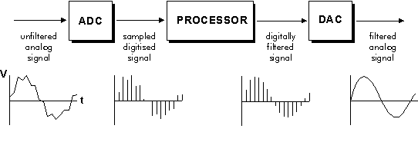
Fourier Analysis Fundamentals Fourier Transform – From Continuous to Discrete Signals

Slide 28
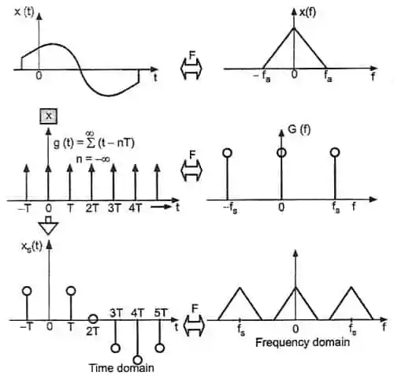
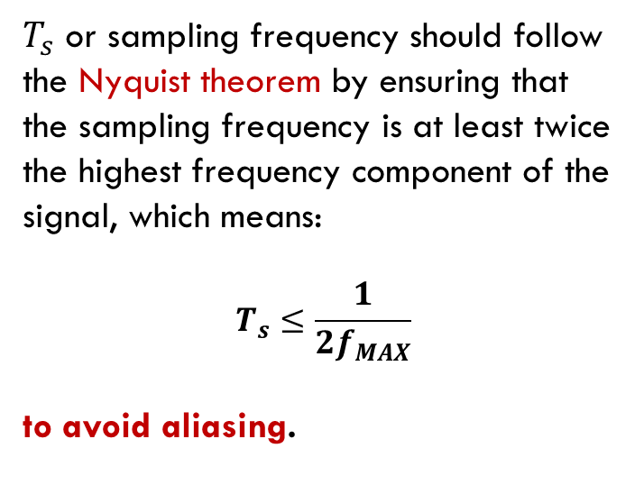
Fourier Analysis Fundamentals Fourier Transform – From Continuous to Discrete Signals
$T_{s}$ or sampling frequency should follow the Nyquist theorem by ensuring that the sampling frequency is at least twice the highest frequency component of the signal, which means:
$$T_{s}≤\frac{1}{2f_{MAX}}$$
to avoid aliasing.

Slide 29
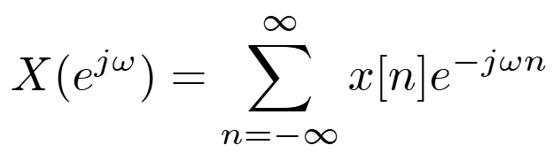
Fourier Analysis Fundamentals DTFT: Bridging Discrete Time and Continuous Frequency
The DTFT transforms a discrete-time signal into its continuous frequency representation.
The formula resembles the continuous Fourier Transform, but with summation instead of integration.
DTFT maintains the fundamental concept of decomposing signals into frequency components.
Mathematically represented as:

Slide 30
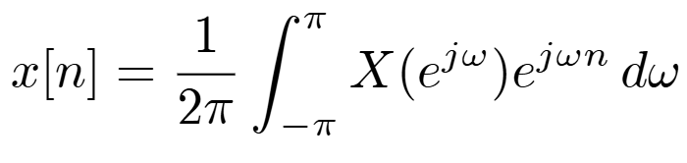
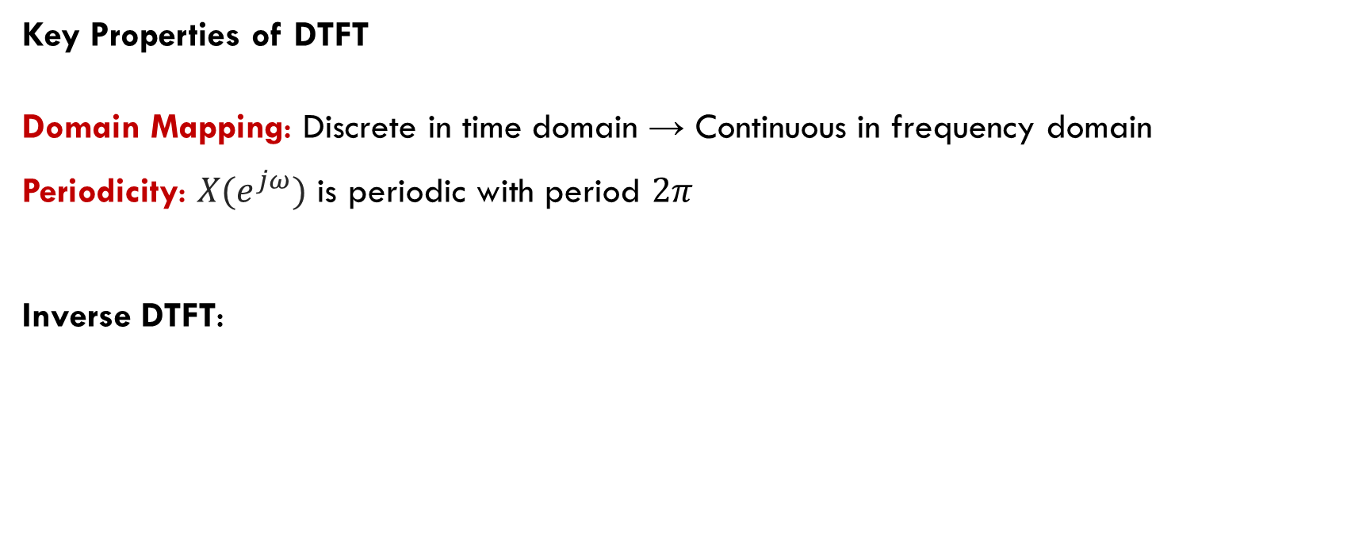
Fourier Analysis Fundamentals DTFT Characteristics
Key Properties of DTFT
Domain Mapping: Discrete in time domain → Continuous in frequency domain
Periodicity: $X(e^{jω})$ is periodic with period $2π$
Inverse DTFT:

Slide 31
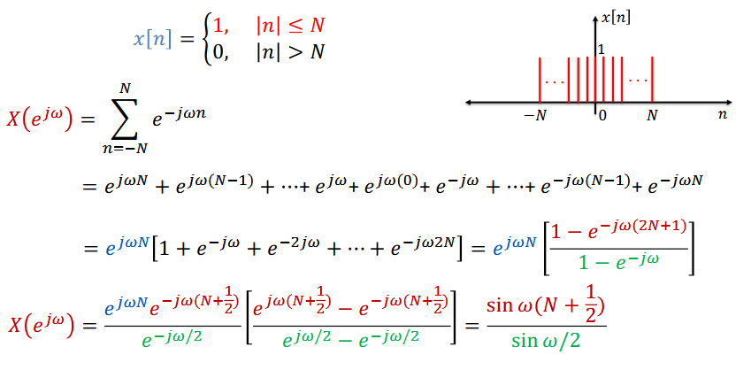
Fourier Analysis Fundamentals DTFT Example

Slide 32
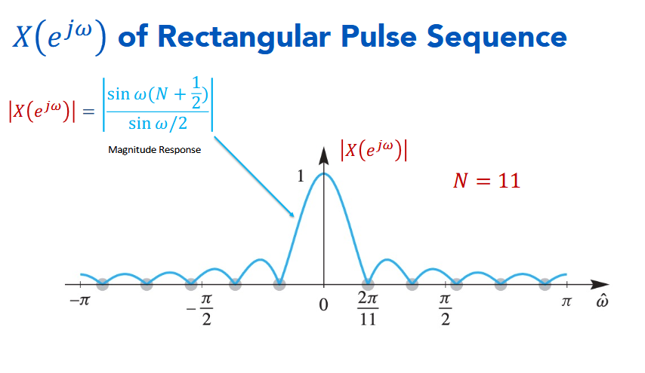
Fourier Analysis Fundamentals DTFT Example

Slide 33
Discrete Fourier Series (DFS)

Slide 34
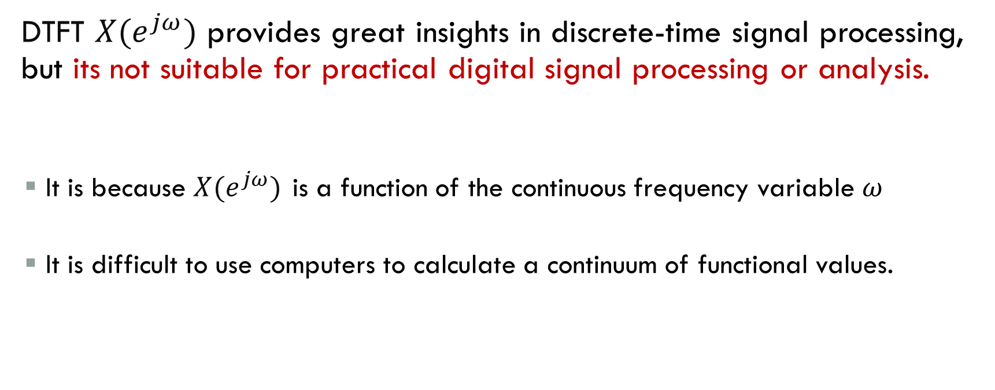
Fourier Analysis Fundamentals Why DFS, DFT and FFT?
DTFT $X(e^{jω})$ provides great insights in discrete-time signal processing, but its not suitable for practical digital signal processing or analysis.
It is because $X(e^{jω})$ is a function of the continuous frequency variable 𝜔
It is difficult to use computers to calculate a continuum of functional values.

Slide 35
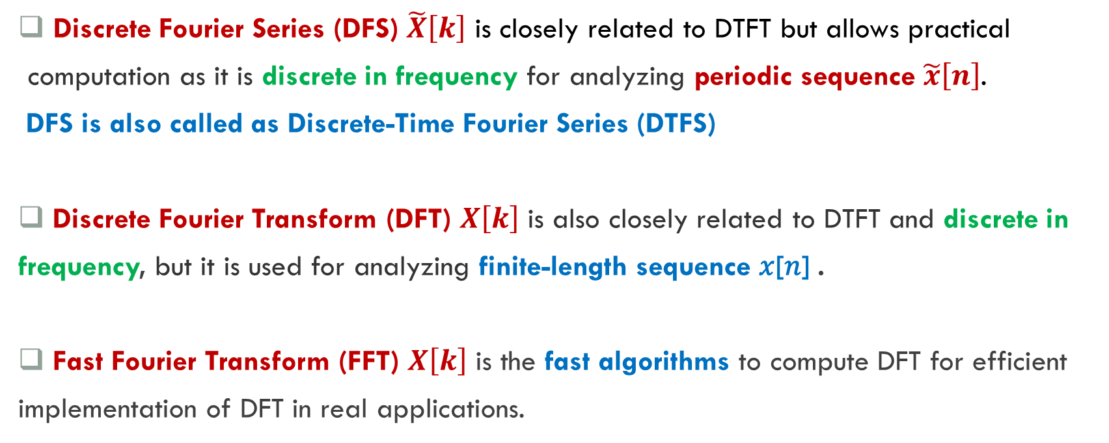
Fourier Analysis Fundamentals What are DFS, DFT and FFT?
Discrete Fourier Series (DFS) $\tilde{X}\left[k\right]$ is closely related to DTFT but allows practical
computation as it is discrete in frequency for analyzing periodic sequence $\tilde{x}\left[n\right]$.
DFS is also called as Discrete-Time Fourier Series (DTFS)
Discrete Fourier Transform (DFT) $X\left[k\right]$ is also closely related to DTFT and discrete in
frequency, but it is used for analyzing finite-length sequence 𝑥[𝑛] .
Fast Fourier Transform (FFT) $X\left[k\right]$ is the fast algorithms to compute DFT for efficient
implementation of DFT in real applications.

Slide 36
Fourier Analysis Fundamentals THE KEY RELATIONSHIP between DFS and dft
The crucial insight is that the DFT implicitly assumes that the finite-length sequence it operates on is one period of an infinite periodic signal.
When we compute the DFT of a length-N sequence, we're actually computing the DFS coefficients of a periodic extension of that sequence.
The mathematical operation is identical, but the conceptual framework differs:
DFS: Starts with a periodic signal, finds its frequency components
DFT: Starts with a finite signal, treats it as one period of a periodic signal, then finds frequency components

Slide 37
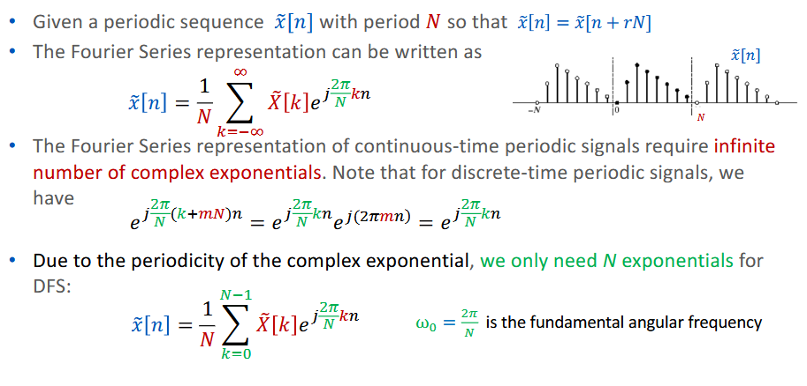
Fourier Analysis Fundamentals Discrete Fourier Series (DFS)

Slide 38
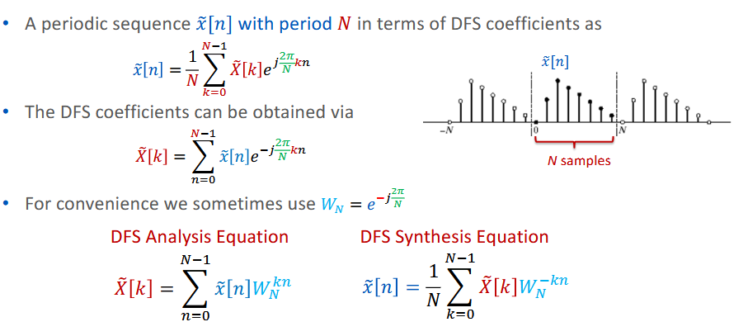
Fourier Analysis Fundamentals Discrete Fourier Series (DFS)

Slide 39
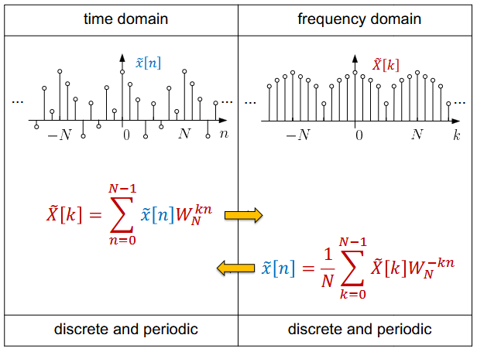
Fourier Analysis Fundamentals Illustration of DFS

Slide 40
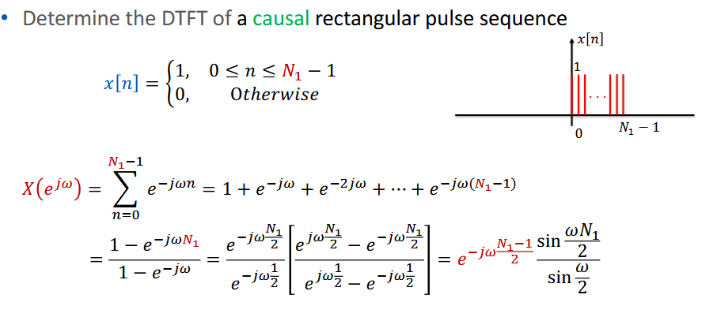
Fourier Analysis Fundamentals DTFT of Causal Rectangular Pulse Sequence

Slide 41
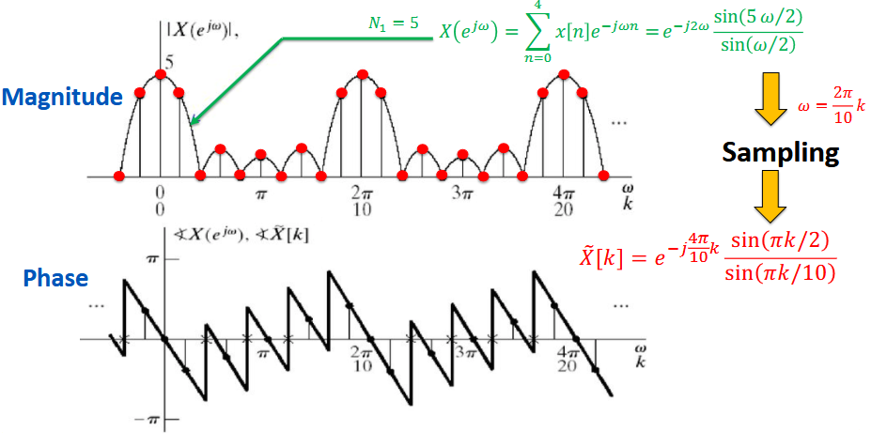
Fourier Analysis Fundamentals Relationship between DFS and DTFT

Slide 42
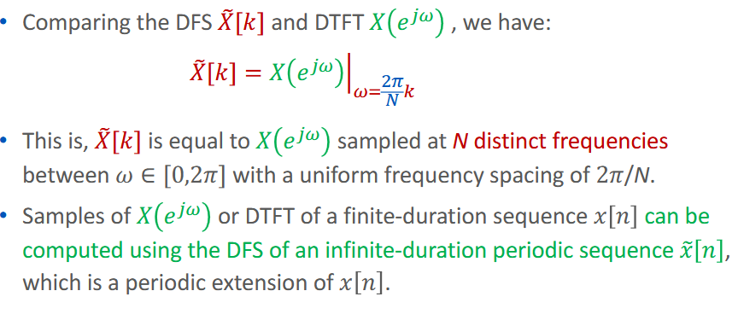
Fourier Analysis Fundamentals Relationship between DFS and DTFT

Slide 43
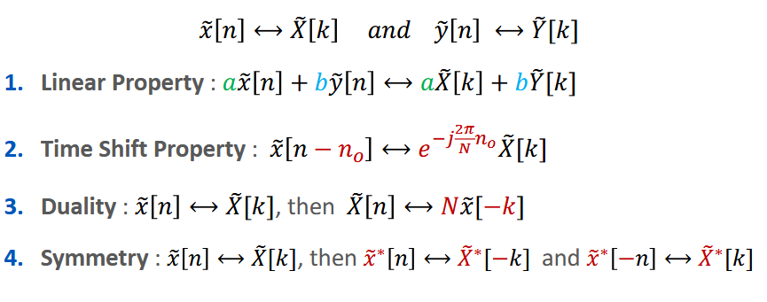
Fourier Analysis Fundamentals Properties of the DFS

Slide 44
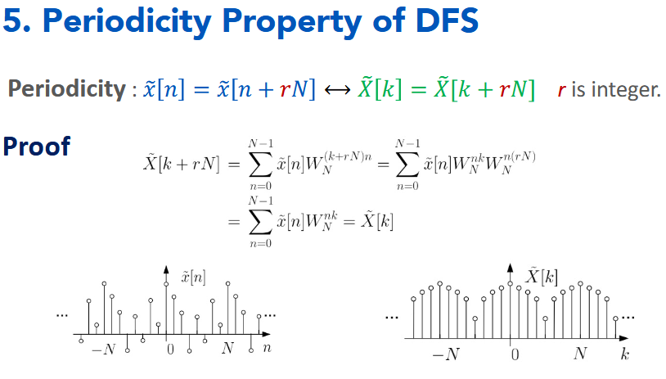
Fourier Analysis Fundamentals Properties of the DFS

Slide 45
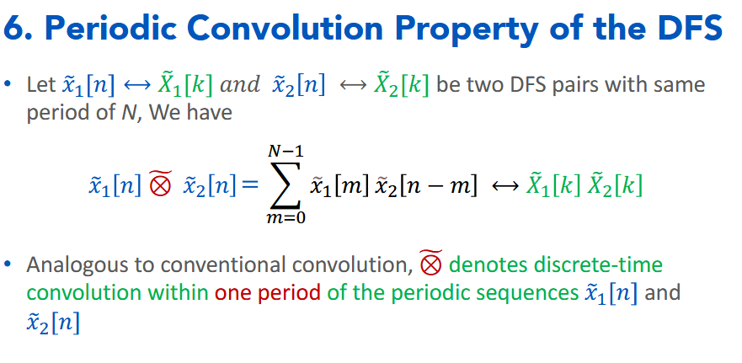
Fourier Analysis Fundamentals Properties of the DFS

Slide 46
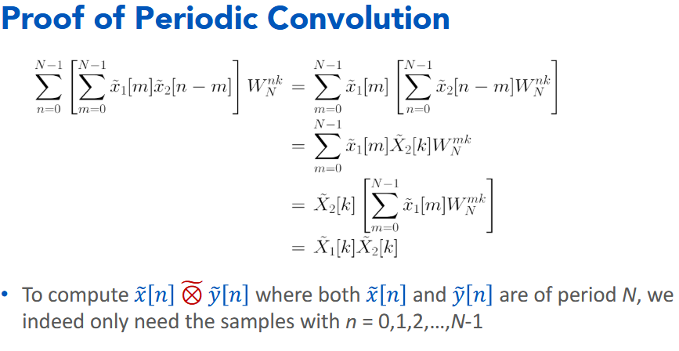
Fourier Analysis Fundamentals Properties of the DFS

Slide 47

Fourier Analysis Fundamentals Convolution of Finite-Duration Sequences

Slide 48

Fourier Analysis Fundamentals Convolution of Finite-Duration Sequences

Slide 49
M-Dimensional Discrete Fourier Series (DFS)

Slide 50
Introduction to M-Dimensional DFT(DFS)
Extends the concept of 1D DFT to multiple dimensions
Analyzes signals that vary across multiple independent variables
Transforms multi-dimensional spatial/temporal data to frequency domain
Reveals frequency patterns that may be invisible in spatial domain
Common Applications by Dimension
2D: Images, spatial patterns, surfaces
3D: Volumetric data, MRI scans, seismic data
4D: Time-varying 3D data, functional MRI
M>4: Hyperspectral imaging, tensor analysis

Slide 51


Introduction to M-Dimensional DFT(DFS)
M-Dimensional DFT:
M-Dimensional IDFT:

Slide 52

M-dimensional dft The Separability Property
M-dimensional DFT can be computed as a sequence of 1D DFTs
Apply 1D DFT along each dimension sequentially
Drastically reduces computational complexity

Slide 53


2D dft The Foundational Case
2D DFT formula:
2D IDFT formula:

Slide 54

2D dft Examples

Slide 55

2D dft Examples

Slide 56


2D dft Examples - Filtering

Slide 57
Discrete Cosine Transform (DCT)

Slide 58

Discrete Cosine Transform (DCT) From DFT to DCT: Why DCT?
Limitation of DFT
Produces complex coefficients $→$ Needs more bits to represent.
DCT Advantage
Real coefficients (easier processing) $→$ Needs Less bits to represent.
DCT: Produces real-valued coefficients for real input data (e.g., pixel values). This simplifies storage and processing.
DFT: Generates complex coefficients, doubling memory requirements and computational complexity without providing benefits for real-world images.

Slide 59
Discrete Cosine Transform (DCT) From DFT to DCT: Why DCT?
DFT: Assumes the signal is periodic, leading to abrupt discontinuities at image boundaries (e.g., edges between the first and last pixel). This introduces artificial high-frequency components (Gibbs phenomenon), causing visible artifacts like "ringing.“
DCT: Uses even symmetry (mirroring) at boundaries, which avoids discontinuities. This results in smoother transitions and fewer artifacts, making it ideal for block-based processing (e.g., 8x8 blocks in JPEG).

Slide 60




Discrete Cosine Transform (DCT) From DFT to DCT: Why DCT?
DFT Assumes the signal is periodic
Zero Pad

Slide 61


Discrete Cosine Transform (DCT) 1 DIMENSIONAL DCT
1D- FORWARD DCT
1D- INVERSE DCT

Slide 62

Discrete Cosine Transform (DCT) 1 DIMENSIONAL DCT

Slide 63

Discrete Cosine Transform (DCT) 1 DIMENSIONAL DCT

Slide 64



Discrete Cosine Transform (DCT) 2 DIMENSIONAL DCT
2D- FORWARD DCT
2D- INVERSE DCT

Slide 65

Discrete Cosine Transform (DCT) 2 DIMENSIONAL DCT
The 2-D DCT is performed as two sequential 1-D DCTs

Slide 66


Discrete Cosine Transform (DCT) 2 DIMENSIONAL DCT
$$b\left(0,0\right)→Low Frequency in both Dimensions$$
$$b\left(7,7\right)→High Frequency in both Dimensions$$

Slide 67

Discrete Cosine Transform (DCT) 2 DIMENSIONAL DCT

Slide 68

Discrete Cosine Transform (DCT) 2 DIMENSIONAL DCT

Slide 69

Discrete Cosine Transform (DCT) 2 DIMENSIONAL DCT - Watermarking

Slide 70


Discrete Cosine Transform (DCT) 2 DIMENSIONAL DCT
$$Zig-zag DCT coefficients ordering$$
Orders coefficients from low to high frequencies
Optimizes run-length encoding in compression algorithms
Exploits fact that significant coefficients cluster at low frequencies

Slide 71

Discrete Cosine Transform (DCT) Coefficient Distribution
DC (First Coefficient)
DCT Distribution

Slide 72

Discrete Cosine Transform (DCT) Coefficient Distribution
Second Coefficient
DCT Distribution

Slide 73

Discrete Cosine Transform (DCT) Coefficient Distribution
Third Coefficient
DCT Distribution

Slide 74


Discrete Cosine Transform (DCT) Statistics of DCT Coefficients

Slide 75

Discrete Cosine Transform (DCT) Coefficient Distribution
The more we go further (from first coefficient to later) the Mean of the Distribution becomes Less and Less (Around Zero), Suggesting that coefficients are around zero.
And also the variance becomes less and less suggesting the same result.
Why This Matters?
Compact representation possible
Most signal energy contained in few coefficients
Later coefficients often negligible
Enables compression strategies
$$Early coefficients → Essential information$$
$$Later coefficients → Can often be discarded$$

Slide 76

Discrete Cosine Transform (DCT) COMPRESSION EXAMPLE

Slide 77

Discrete Cosine Transform (DCT) DCT BLOCK-BASED CODING EXAMPLE

Slide 78

Discrete Cosine Transform (DCT) DCT vs. KLT Performance Comparison
For Markov sources with high correlation coefficients, DCT provides nearly optimal decorrelation comparable to the theoretically optimal KLT.
Markov process correlation:
Higher ρ values indicate stronger temporal/spatial correlation between adjacent samples.

Slide 79

Discrete Cosine Transform (DCT) DCT vs. KLT Performance Comparison
Example shown:
ρ = 0.95, n = 16 (highly correlated data)
Multiple transform methods compared:
KLT (Karhunen-Loève Transform) - theoretically optimal
DCT (Discrete Cosine Transform)
Haar Transform
Walsh-Hadamard Transform
Kekre-Levy Transform

Slide 80
Discrete Cosine Transform (DCT) DCT vs. KLT Performance Comparison
Why This Matters ?
DCT is used in JPEG, MPEG, H.26x compression standards because it provides near-optimal decorrelation with fast computation
KLT requires knowledge of signal statistics and higher computational complexity
For ρ → 1, DCT asymptotically approaches KLT optimality for first-order Markov processes

Slide 81

Discrete Cosine Transform (DCT) Efficient Computation
1-D DCT can be computed via DFT with signal mirroring.

Slide 82

Discrete Cosine Transform (DCT) Efficient Computation

Slide 83
Comparison Between Transforms

Slide 84

Transforms A COMPARISON

